Slide 1

Electrical Appliance Use in Blackwood Home and Care
Group16:
Huiwei Chen
Tuji Yu
Yiting Zhao
Zhihan Yang
Zilin Lu
Notes:
What life is like in a nursing home?
In this project, we answer and expand this question from the aspect of electrical appliance use.

Slide 2
Introduction
Questions raised
What it is like to live in a nursing home?
Are there any patterns of electrical appliance use?
How do the staff of nursing home improve occupants’ life quality?
Audience
Families of the occupants
Staff of Blackwood nursing home
People who are interested in the life in Blackwood
Notes:
The appliances bring convenience but also potential dangers.
Be it families or nursing home staff, they are all concerned about safety issues.
So we try to discover the connection between appliances and occupants and also provide suggestions to staff for future improvements.

Slide 3
Introduction
Data
15 Blackwood nursing homes (csv files)
Timestamp: from 2017 to 2020, e.g. 2017-05-19 10:00:00
Power Value: electrical appliances’ instantaneous power, e.g. 2368
Notes:
The data we’ve got are from 15 Blackwood nursing homes.
Each csv file represents one electrical appliance’s records of real-time power value.

Slide 4
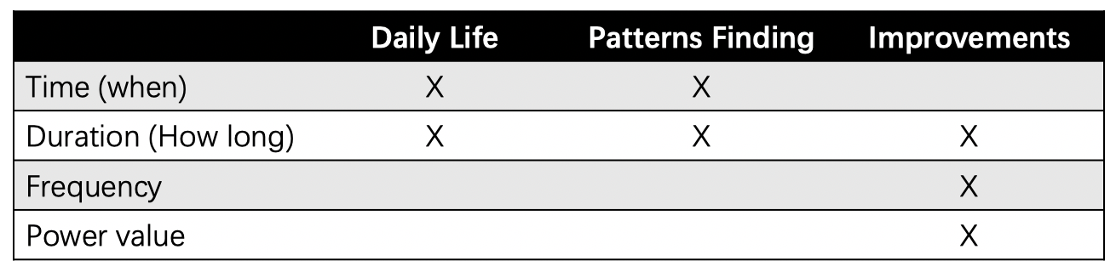
Data Analysis
Cleaning
Repetitive items (timestamp, ID…)
Errors of sensor measurement
Analyzing
Notes:
After the cleaning, we applied four dimensions to analyse data for different purposes and show the outcomes by video.

Slide 5
Project
Design choice - An advertising video of nursing home
Part 1 - A narrative diary to show daily life in nursing home
Part 2 - How do we use data to improve the services in nursing home:
Find Habits and Patterns of electrical appliances usage
Improve Customized Services
Make purchase decision
Maintain appliances
Detect abnormality
Notes:
The advertising video is from the perspective of staff. It starts from an imagined diary, to patterns and finally to the improvements divided in three parts.

Slide 6
Project
Implication
Make families know more about the life in nursing homes
Promote the service in Blackwood Homes
Attract potential occupants
Notes:
The video aims to make families know more and promote staff to provide better services so as to improve life standard and attract potential occupants.

Slide 7
Project Video
Notes:
And now let’s have a look at it.

Slide 8
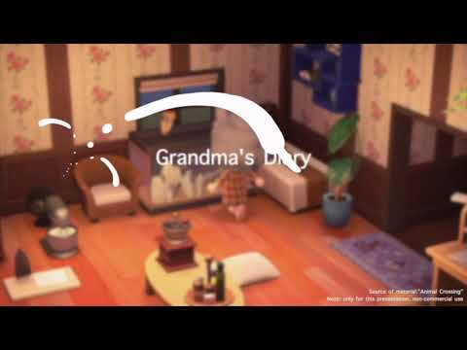

Slide 9
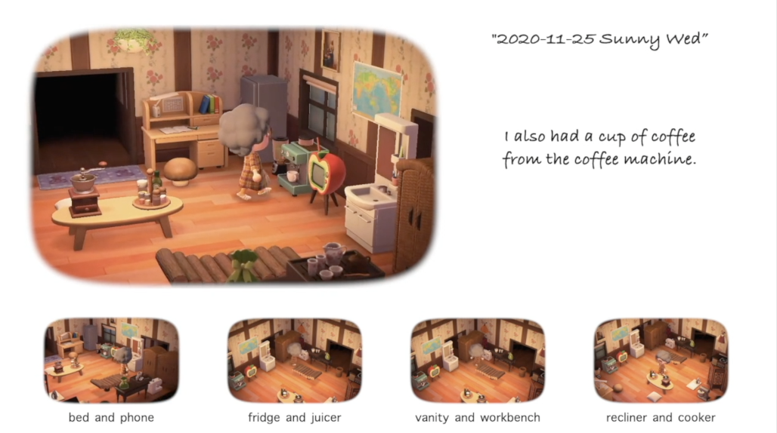
Design Rationale
Diary
Diary as carrier to present the real daily life of host
Four small videos in the bottom to highlight the appliance usage
Notes:
script:
In part 1, we record a daily routine of a host using “Animal Crossing”.

Slide 10
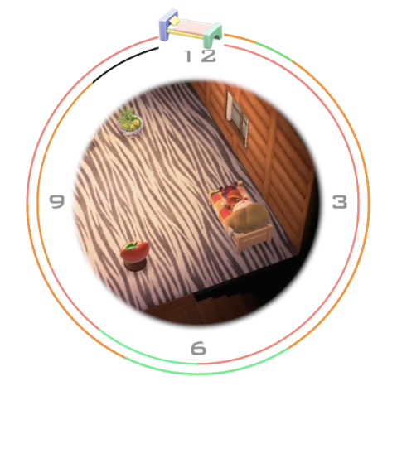
Design Rationale
Habits and patterns
Two circles to show 24 hours in a day
Clock within the circle to give a sense of time passing
Icon rotating along the outer circle to show what appliance may be in used in each hour
Icons leave traces of different colors to show the habit of using electrical appliances in this home
Notes:
script:

Slide 11
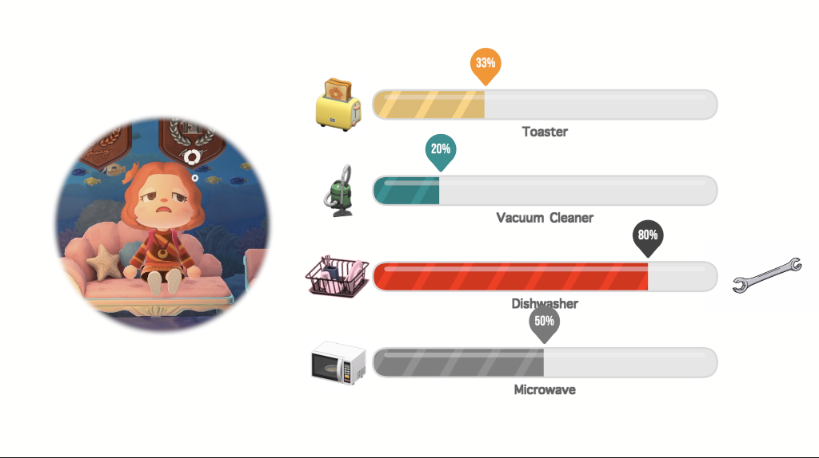
Design Rationale
Maintain appliances
Use the progress bar to indicate the ratio of the current usage time to the service life to give a sense of appliance life’s passing
When the ratio is equal to or more than 80%, color the progress bar with red to give a sense of warning
Notes:
script:

Slide 12
Limitation and Bias
Lack of more data about electrical appliances, so unable to conduct a more accurate analysis to appliances, such as remaining life
Lack of more detailed personal information data, so unable to conduct statistical analysis on pattern and personal information
Unstable sensor operation leads to missing data, which in turn causes data analysis errors
Notes:
script:

Slide 13
Q & A
Notes:
script:
Any questions?

Slide 14
Thank you
Notes:
script:
Thank you for your listening.

Slide 15
Limitation and Bias
●Unclear information about appliances.
For example, the model number and life span. We just know the types of appliances, but we are not given more detailed information of each appliance. If we know more, we can offer better service towards repair and replacement.
●Lack of detailed personal information about occupants.
We just have personal information of 15 occupants now, so we cannot connect their characteristics with their appliances usage pattern definitely. If we have information of more occupants, we may get more clear regularities and offer targeted service and help.
Notes:
script:

Slide 16
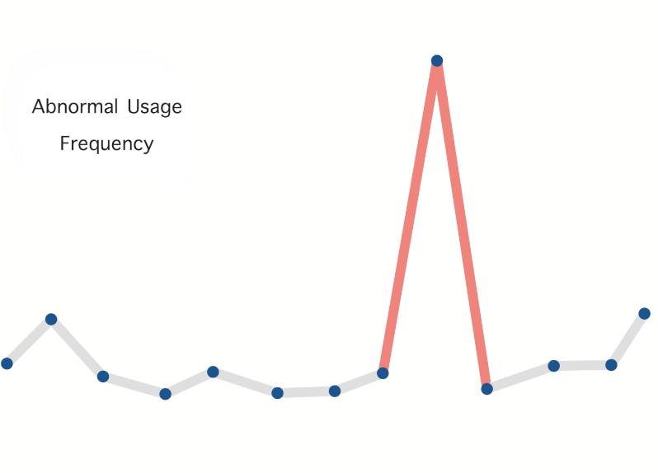
Design Rationale
Detect abnormality
Use different color in line chart when abonrmality appears to give a sense of warning
Notes:
script:

